Slide 1




Sorting and Searching
Algorithms
Sorting, Searching, Shuffling
Sorting
Searching
SoftUni Team
Technical Trainers
Software University
http://softuni.bg

Slide 2


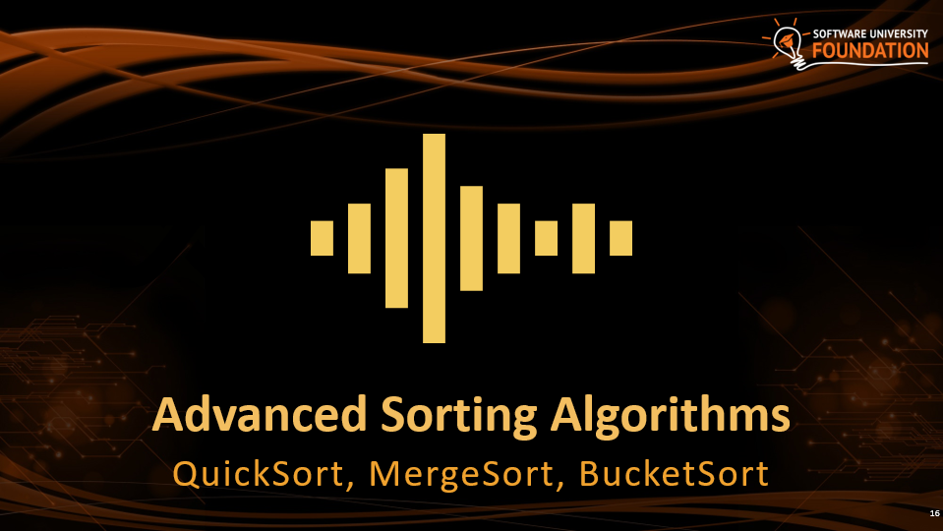

Table of Contents

Slide 3

Simple Sorting Algorithms
BubbleSort, InsertionSort, SelectSort

Slide 4
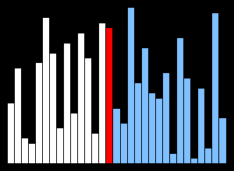
What is a Sorting Algorithm?
Sorting algorithm
  An algorithm that rearranges elements in a list
    In non-decreasing order
  Elements must be comparable
More formally
  The input is a sequence / list of elements
  The output is an rearrangement / permutation of elements
    In non-decreasing order

Slide 5

Sorting – Example
Efficient sorting algorithms are important for
  Producing human-readable output
  Canonicalizing data – making data uniquely arranged
  In conjunction with other algorithms, like binary searching
Example of sorting:
Unsorted list
sorting
Sorted list
10 | 3 | 7 | 3 | 4
3 | 3 | 4 | 7 | 10

Slide 6
Sorting Algorithms: Classification
Sorting algorithms are often classified by
  Computational complexity and memory usage
    Worst, average and best case behavior
  Recursive / non-recursive
  Stability – stable / unstable
  Comparison-based sort / non-comparison based
  Sorting method: insertion, exchange (bubble sort and quicksort), selection (heapsort), merging, serial / parallel, etc.

Slide 7
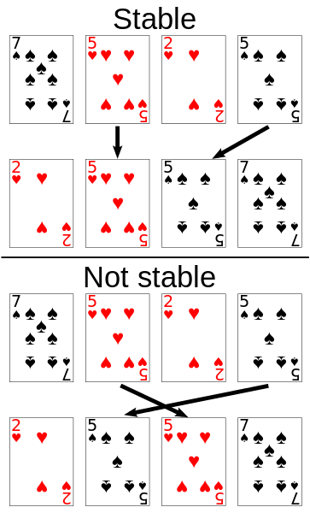
Stability of Sorting
Stable sorting algorithms
  Maintain the order of equal elements
  If two items compare as equal, their relative order is preserved
Unstable sorting algorithms
  Rearrange the equal elements in unpredictable order
Often different elements have same key used for equality comparing

Slide 8
Sorting Helper Methods
static void Swap<T>(T[] collection, int from, int to)
{
//TODO: Swap the elements
}
static bool Less(IComparable first, IComparable second)
{
return first.CompareTo(second) < 0;
}

Slide 9
Selection Sort
Selection sort – simple, but inefficient algorithm (visualize)
  Swap the first with the min element on the right, then the second, etc.
  Memory: O(1)
  Stable: No
  Method: Selection

Slide 10
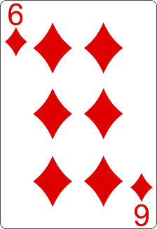
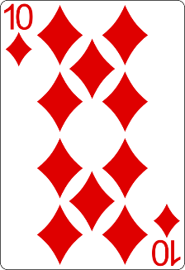
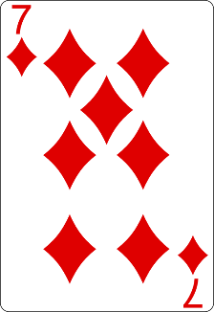
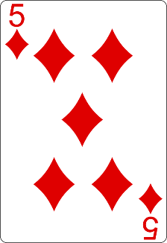
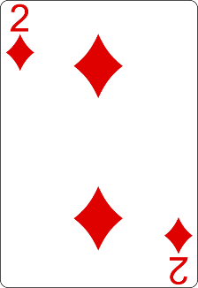
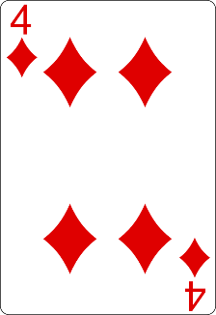
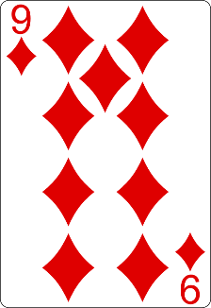
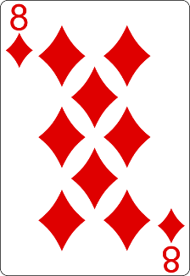
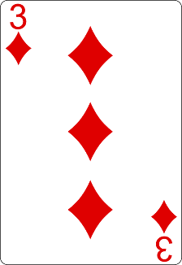
Selection Sort Visualization
Index
Min

Slide 11
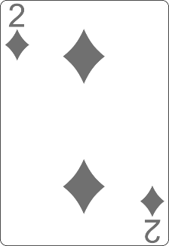
Selection Sort Visualization
Index
Min

Slide 12
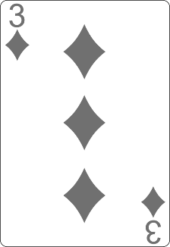
Selection Sort Visualization
Index
Min

Slide 13
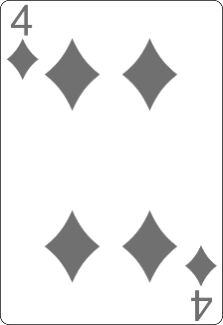
Selection Sort Visualization
Min
Index

Slide 14
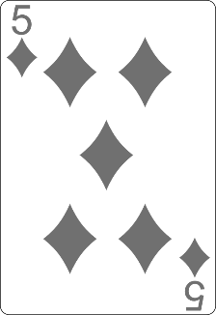
Selection Sort Visualization
Min
Index

Slide 15
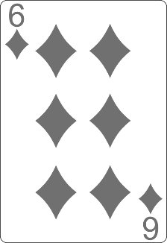
Selection Sort Visualization
Min
Index

Slide 16
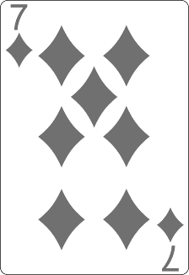
Selection Sort Visualization
Index
Min

Slide 17
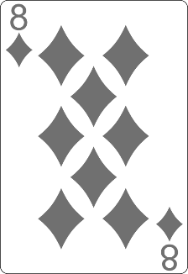
Selection Sort Visualization
Min
Index

Slide 18
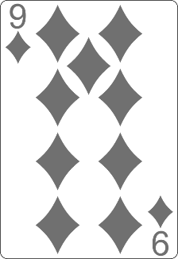
Selection Sort Visualization
Min
Index

Slide 19
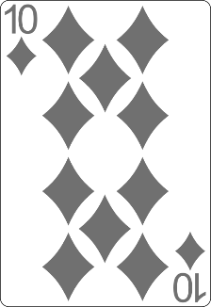
Selection Sort Visualization

Slide 20
Selection Sort Visualization

Slide 21
Selection Sort: Why Unstable?
Why the "selection sort" is unstable?
  Swaps the first element with the min element on the right
  Swaps the second element with the min element on the right
  …
During the swaps equal elements can jump over each other
left
min
swap
equal elements
changed order
3♥ | 5♠ | 3♦ | 4♥ | 2♣
3♥ | 5♠ | 3♦ | 4♥ | 2♣
2♣ | 5♠ | 3♦ | 4♥ | 3♥

Slide 22
Selection Sort Code
for (int index = 0; index < collection.Length; index++)
{
int min = index;
for (int curr = index + 1; curr < collection.Length; curr++)
{
if (Less(collection[curr], collection[min]))
{
min = curr;
}
}
Swap(collection, index, min);
}

Slide 23
Comparison of Sorting Algorithms
Name | Best | Average | Worst | Memory | Stable | Method
SelectionSort | n² | n² | n² | 1 | No | Selection

Slide 24
Bubble Sort
Bubble sort – simple, but inefficient algorithm (visualize)
  Swaps to neighbor elements when not in order until sorted
  Memory: O(1)
  Stable: Yes
  Method: Exchanging

Slide 25
Bubble Sort Visualization
i
j

Slide 26
Bubble Sort Visualization
i
j

Slide 27
Bubble Sort Visualization
i
j

Slide 28
Bubble Sort Visualization
i
j

Slide 29
Bubble Sort Visualization
i
j

Slide 30
Bubble Sort Visualization
i
j

Slide 31
Bubble Sort Visualization
i
j

Slide 32
Bubble Sort Visualization
i
j

Slide 33
Bubble Sort Visualization
i
j

Slide 34
Bubble Sort Visualization
i
j

Slide 35
Bubble Sort Visualization
i
j

Slide 36
Bubble Sort Visualization
i
j

Slide 37
Bubble Sort Visualization
i
j

Slide 38
Bubble Sort Visualization
i
j

Slide 39
Bubble Sort Visualization
i
j

Slide 40
Bubble Sort Visualization
i
j

Slide 41
Bubble Sort Visualization
i
j

Slide 42
Bubble Sort Visualization
i
j

Slide 43
Bubble Sort Visualization
i
j

Slide 44
Bubble Sort Visualization
i
j

Slide 45
Bubble Sort Visualization
i
j

Slide 46
Bubble Sort Visualization
i
j

Slide 47
Bubble Sort Visualization
i
j

Slide 48
Bubble Sort Visualization
i
j

Slide 49
Bubble Sort Visualization
i
j

Slide 50
Bubble Sort Visualization
i
j

Slide 51
Bubble Sort Visualization
i
j

Slide 52
Bubble Sort Visualization
i
j

Slide 53
Bubble Sort Visualization
i
j

Slide 54
Bubble Sort Visualization
i
j

Slide 55
Bubble Sort Visualization
i
j

Slide 56
Bubble Sort Visualization
i
j

Slide 57
Bubble Sort Visualization
i
j

Slide 58
Bubble Sort Visualization
i
j

Slide 59
Bubble Sort Visualization
i
j

Slide 60
Bubble Sort Visualization

Slide 61
Comparison of Sorting Algorithms
Name | Best | Average | Worst | Memory | Stable | Method
SelectionSort | n² | n² | n² | 1 | No | Selection
BubbleSort | n | n² | n² | 1 | Yes | Exchanging

Slide 62
Insertion Sort
Insertion sort – simple, but inefficient algorithm (visualize)
  Move the first unsorted element left to its place
  Memory: O(1)
  Stable: Yes
  Method: Insertion

Slide 63
Comparison of Sorting Algorithms
Name | Best | Average | Worst | Memory | Stable | Method
SelectionSort | n² | n² | n² | 1 | No | Selection
BubbleSort | n | n² | n² | 1 | Yes | Exchanging
InsertionSort | n | n² | n² | 1 | Yes | Insertion

Slide 64

Shuffling
Fisher-Yates Shuffle

Slide 65
Shuffling
Shuffling == randomizing the order of items in a collection
  Generate a random permutation
The generation of random numbers is too important to be left to chance. —Robert R. Coveyou

Slide 66
Fisher–Yates Shuffle Algorithm
public static void Shuffle<T>(T[] source)
{
Random rnd = new Random();
for (int i = 0; i < source.Length; i++)
{
// Exchange array[i] with random element in array[i … n-1]
int r = i + rnd.Next(0, source.Length - i);
T temp = source[i];
source[i] = source[r];
source[r] = temp;
}
}
Shuffle algorithms: visualization

Slide 67


Advanced Sorting Algorithms
QuickSort, MergeSort, BucketSort

Slide 68
Merge Sort
Merge sort is efficient sorting algorithm (visualize)
  Divide the list into sub-lists (typically 2 sub-lists)
  Sort each sub-list (recursively call merge-sort)
  Merge the sorted sub-lists into a single list
Best, average and worst case: O(n*log(n))
Memory:
  Typically O(n)
  With in-place merge can be O(1)
Highly parallelizable on multiple cores / machines → up to O(log(n))
Stable: Yes
Method: Merging

Slide 69
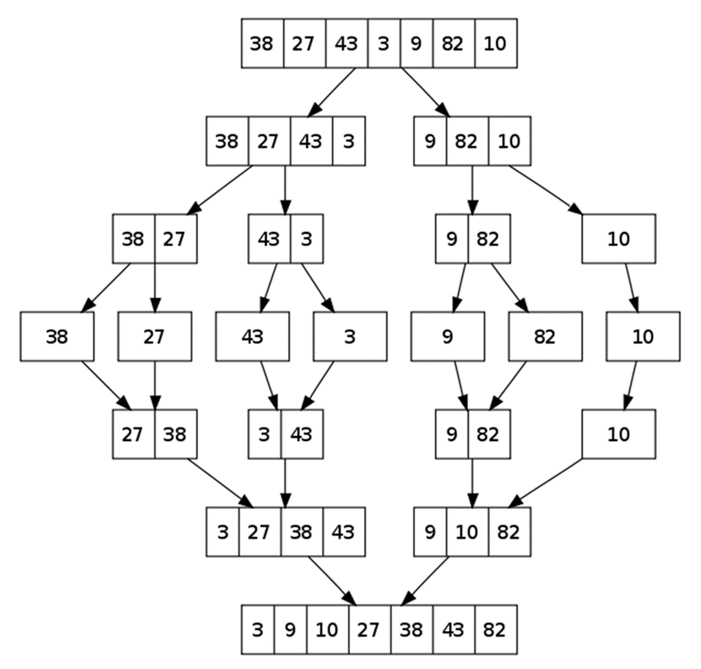
Merge Sort: Hot It Works?

Slide 70
QuickSort
QuickSort – efficient sorting algorithm (visualize)
  Choose a pivot; move smaller elements left & larger right; sort left & right
  Best & average case: O(n*log(n)); Worst: O(n²)
  Memory: O(log(n)) stack space (for recursion)
  Stable: Depends
  Method: Partitioning

Slide 71
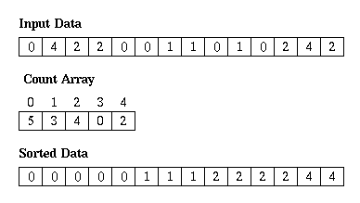
Counting Sort
Counting sort is a very efficient sorting algorithm (visualize)
  Sorts small integers by counting their occurrences
  Not a comparison-based sort
Best, average and worst case: O(n + k)
  k is the range of numbers to be sorted
  E.g. [-1000 ... 1000] → k = 2001
Memory: O(n + k) Space: O(k)
Stable: Yes
Method: Counting

Slide 72
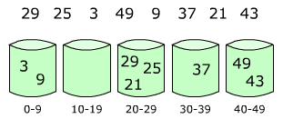
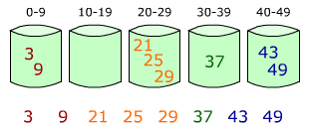
Bucket Sort
Bucket sort partitions an array into a number of buckets
  Each bucket is then sorted individually with a different algorithm
  Not a comparison-based sort
Average case: O(n + k)
  k = the number of buckets
Worst case: O(n * log n)
Stable: Yes (depends on algorithm)
Memory: O(n) – k buckets holding n elements totally

Slide 73
Comparison of Sorting Algorithms
Name | Best | Average | Worst | Memory | Stable | Method
SelectionSort | n² | n² | n² | 1 | No | Selection
BubbleSort | n | n² | n² | 1 | Yes | Exchanging
InsertionSort | n | n² | n² | 1 | Yes | Insertion
QuickSort | n*log(n) | n*log(n) | n² | log(n) | Depends | Partitioning
MergeSort | n*log(n) | n*log(n) | n*log(n) | 1 (or n) | Yes | Merging
HeapSort | n*log(n) | n*log(n) | n*log(n) | 1 | No | Selection
BogoSort | n | n*n! | n*n! | 1 | No | Luck

Slide 74


Searching Algorithms
Linear, Binary and Interpolation

Slide 75

Search Algorithm
Search algorithm == an algorithm for finding an item with specified properties among a collection of items
Different types of searching algorithms
  For virtual search spaces
    Satisfy specific mathematical equations
    Try to exploit partial knowledge about a structure
  For sub-structures of a given structure
    A graph, a string, a finite group
  Search for the min / max of a function, etc.

Slide 76
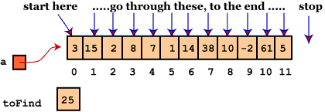
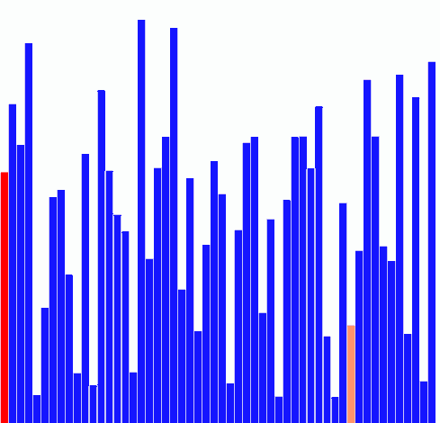
Linear Search
Linear search finds a particular value in a list (visualize)
  Checking every one of the elements
  One at a time, in sequence
  Until the desired one is found
Worst & average performance: O(n)
for each item in the list:
if that item has the desired value,
return the item's location
return nothing

Slide 77
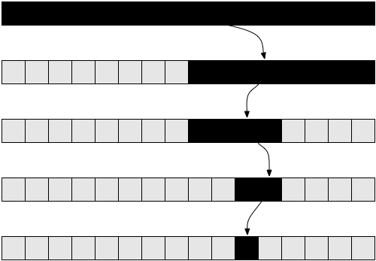
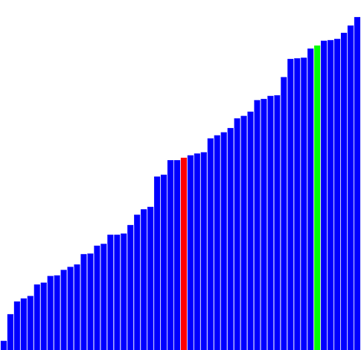
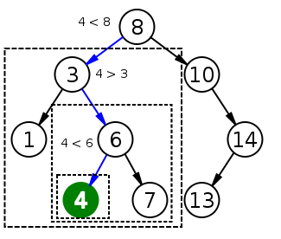
Binary Search
Binary search finds an item within a ordered data structure
At each step, compare the input with the middle element
  The algorithm repeats its action to the left or right sub-structure
Average performance: O(log(n))
See the visualization

Slide 78
Binary Search (Recursive)
int BinarySearch(int arr[], int key, int start, int end) {
if (end < start)
return KEY_NOT_FOUND;
else {
int mid = (start + end) / 2;
if (arr[mid] > key)
return BinarySearch(arr, key, start, mid - 1);
else if (arr[mid] < key)
return BinarySearch(arr, key, mid + 1, end);
else
return mid;
}
}

Slide 79
Binary Search (Iterative)
int BinarySearch(int arr[], int key, int start, int end) {
while (end >= start) {
int mid = (start + end) / 2;
if (arr[mid] < key)
start = mid + 1;
else if (arr[mid] > key)
end = mid - 1;
else
return mid;
}
return KEY_NOT_FOUND;
}

Slide 80
Interpolation Search
Interpolation search == an algorithm for searching for a given key in an ordered indexed array
  Parallels how humans search through a telephone book
  Calculates where in the remaining search space the item might be
    Binary search always chooses the middle element
    Can we have a better hit, e.g. Angel in the phonebook should be at the start, not at the middle, OK?
Average case: log(log(n)), Worst case: O(n)
http://youtube.com/watch?v=l1ed_bTv7Hw

Slide 81
Interpolation Search – Sample Implementation
int InterpolationSearch(int[] sortedArray, int key) {
int low = 0;
int high = sortedArray.Length - 1;
while (sortedArray[low] <= key && sortedArray[high] >= key) {
int mid = low + ((key - sortedArray[low]) * (high - low))
/ (sortedArray[high] - sortedArray[low]);
if (sortedArray[mid] < key)
low = mid + 1;
else if (sortedArray[mid] > key)
high = mid - 1;
else
return mid;
}
if (sortedArray[low] == key) return low;
else return KEY_NOT_FOUND;
}

Slide 82

Summary
Slow sorting algorithms:
  Selection sort, Bubble sort, Insertion sort
Fast sorting algorithms:
  Quick sort, Merge sort, etc.
  How to choose the most appropriate algorithm?
    http://stackoverflow.com/a/1934004
Searching algorithms
  Binary Search, Interpolation Search

